Slide 1

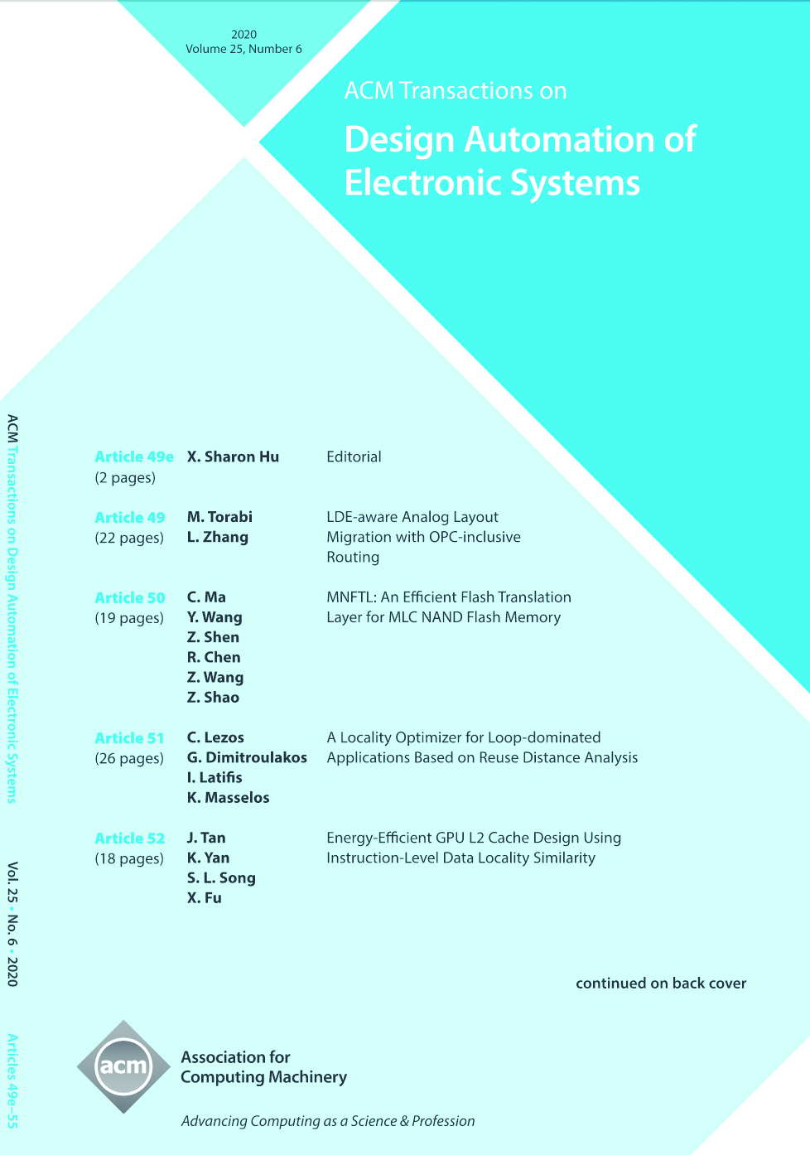

ACM Transactions on Design Automation of Electronic Systems (TODAES)
Editor-in-Chief
Jiang Hu
Texas A&M University (USA)
ACM Transactions on Design Automation of Electronic Systems (TODAES) is a premier ACM journal in design and automation of electronic systems. It publishes innovative work documenting significant research and development advances on the specification, design, analysis, simulation, testing, and evaluation of electronic systems, emphasizing a computer science/engineering orientation. Design automation for machine learning/AI and machine learning/AI for design automation are very much welcomed.
https://todaes.acm.org

