Slide 1
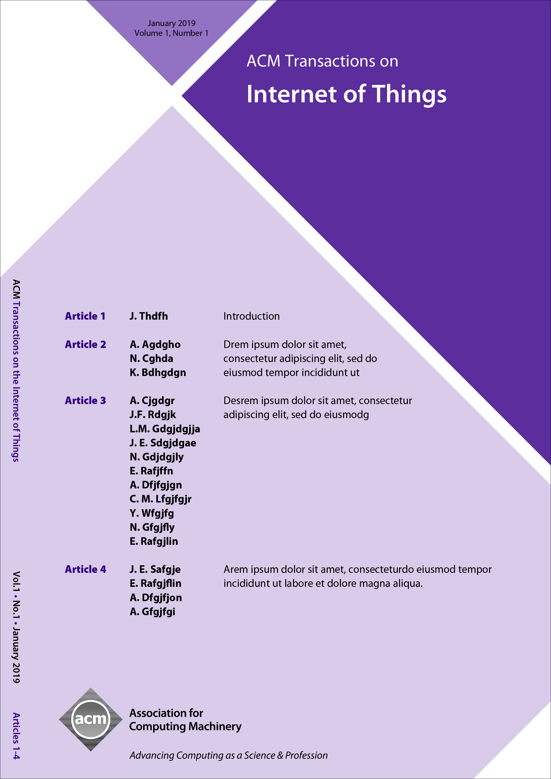


ACM Transactions on Internet of Things (TIOT)
Editor-in-Chief
Gian Pietro Picco
University of Trento, Italy
ACM Transactions on Internet of Things (TIOT) is a new ACM journal that publishes novel research contributions and experience reports in several research domains whose synergy and interrelations enable the IoT vision. TIOT focuses on system designs, end-to-end architectures, and enabling technologies, and on publishing results and insights corroborated by a strong experimental component.
https://tiot.acm.org

