Slide 1

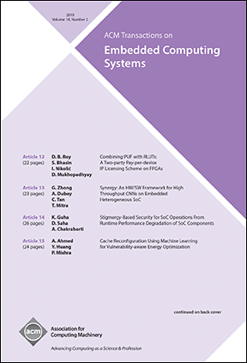

ACM Transactions on Embedded Computing Systems (TECS)
Editor-in-Chief
Tulika Mitra National University of Singapore
The design of embedded computing systems, both the software and hardware, increasingly relies on sophisticated algorithms, analytical models, and methodologies. ACM Transactions on Embedded Computing Systems (TECS) aims to present leading works relating to the analysis, design, behavior, and experience with embedded computing systems.
https://tecs.acm.org

