Slide 1

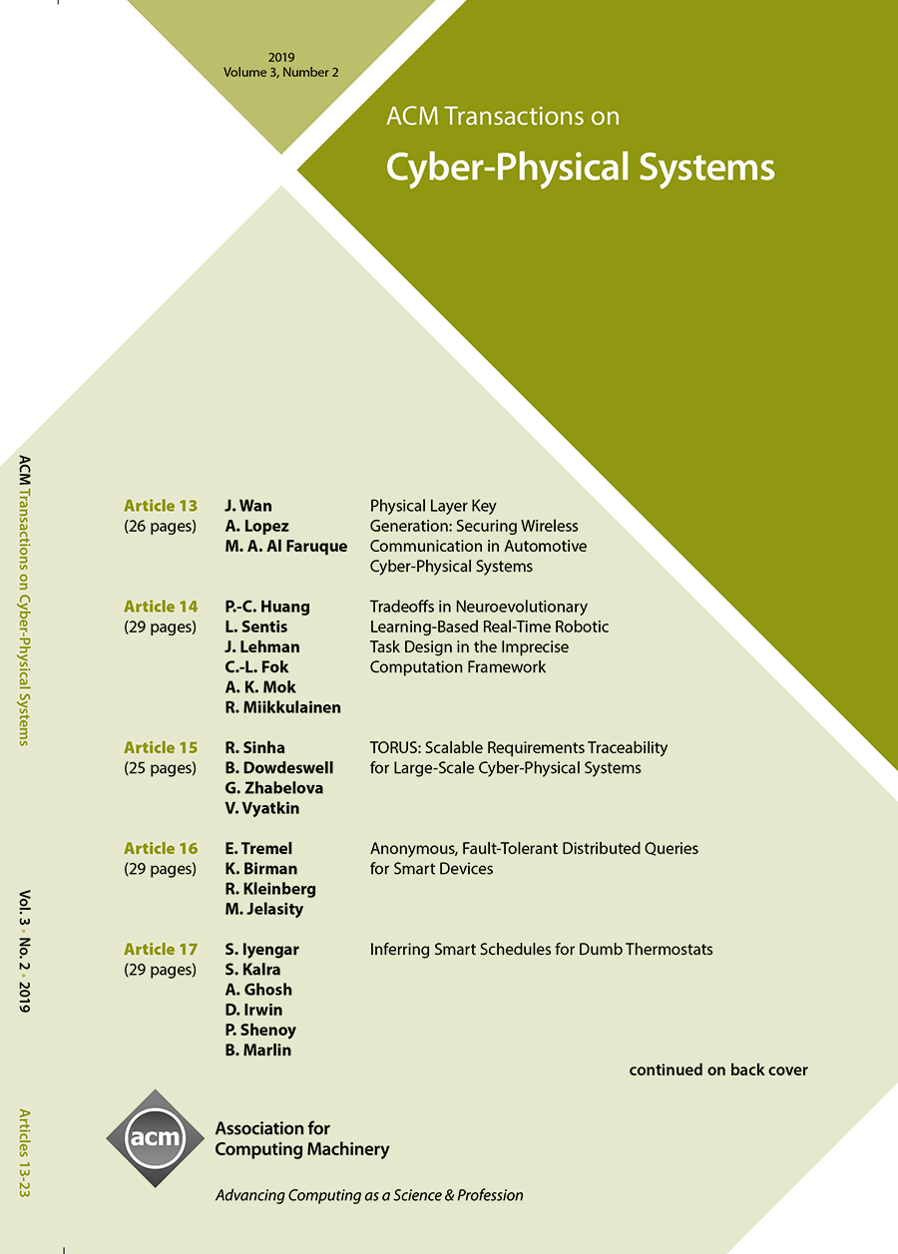

ACM Transactions on Cyber-Physical Systems (TCPS)
Editor-in-Chief
Chenyang Lu
Washington University
in St. Louis
ACM Transactions on Cyber-Physical Systems (TCPS) is the premier journal for the publication of high-quality original research papers and survey papers that have scientific and technological understanding of the interactions of information processing, networking and physical processes. The application domains covered by TCPS include, but not limited to: Healthcare, Transportation, Automotive, Avionics, Energy, Living Space, and Robotics.
https://tcps.acm.org

